Slide 1

Korean Sign Language
Learning Site
Team. 아지들
2020 Database System
Professor. Aziz

Slide 2
CONTENTS
01
02
03
04
05
Team & Roles
Project Idea
Requirement analysis
E-R diagram
Database
06
07
08
09
10
Tuning
Queries
Application
Demo
Conclusion

Slide 3




01
Team & Roles
2017038062 정해경
2016039006 문재식
2017038049 차송희
01
DB Design (ERD)
Requirements Analysis
DB Management
Search Page
DB Implementation
Schema Design
Wordbook Page
Login & Signup Page
Main Page

Slide 4
02
Project Idea
‘Communication Method of the hearing impaired’
Other (1.3%)
Simple Gesture (9.3%)
Writing ( 10.7%)
Korean Sign Language (78.7%)
출처 : 청각 장애인의 언어 사용 실태 여부, 한국 농아인 협회

Slide 5
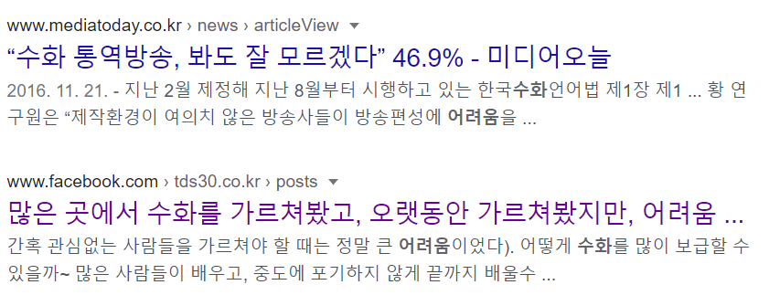
02
Project Idea
‘Difficulty in Sign Language learning, poor accessibility’

Slide 6



02
Project Idea
Increase the Accessibility.
Korean Sign Language Site
Make your own Wordbook.
Easy Learn Sign Language Anyone!

Slide 7
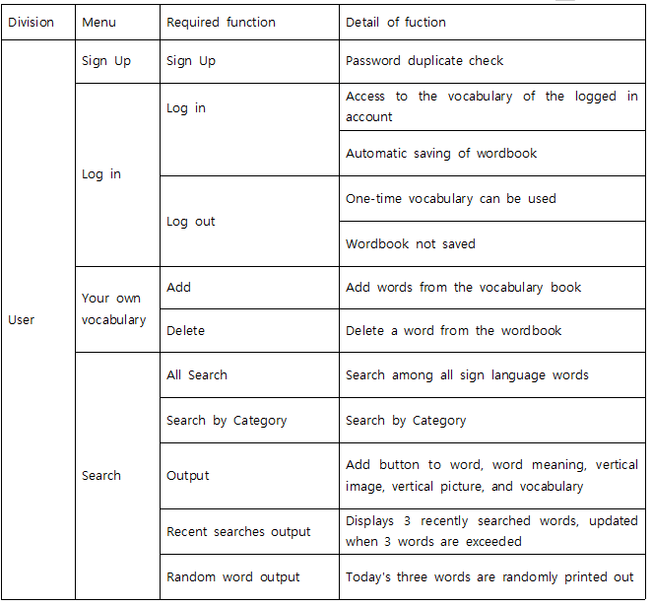
Requirement
analysis
03

Slide 8
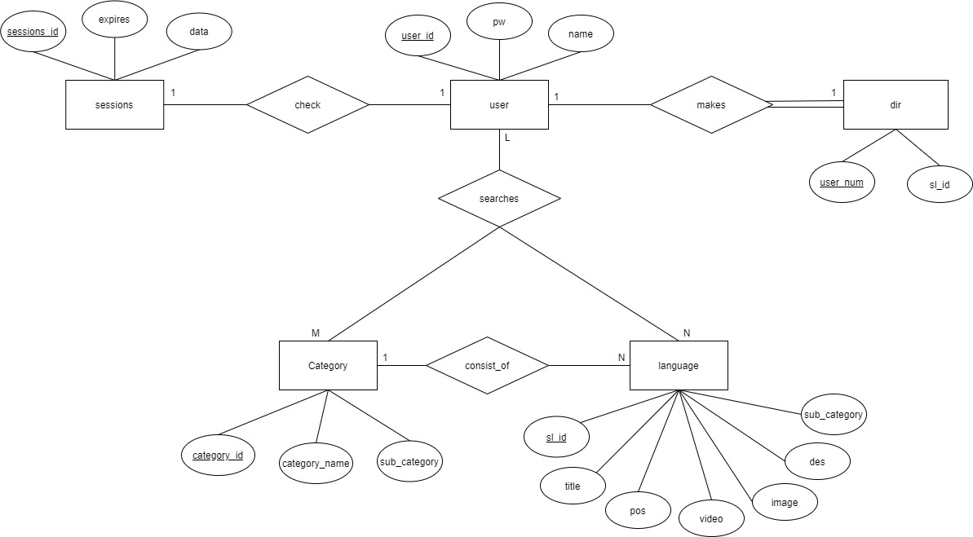
04
E-R diagram

Slide 9
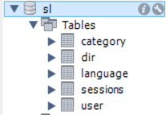
05
Database
Step 1 : Regular Entity Type and Single Value Attribute
user(user_id, pw, name)
dir(user_id, sl_id)
session(session_id, expires, data)
category(category_id, category_name, sub_category)
language(sl_id, sub_category, title, des, video, img, pos)
Step 2 : Weak Entity Type and Single Value Attribute
There’s no weak Entity Type and Single Value Attribute
Step 3 : Binary 1:1 Relationship Type
dir(user_id, sl_id, id)
session(session_id, expires, data)

Slide 10
05
Database
Step 4 : Regular binary 1:N relationship type
language(sl_id, sub_category, title, des, video, img, pos, category)
Step 5 : Binary M:N relationship type
There’s no binary M:N relationship type
Step 6 : Ternary or higher relationship types
Search (user_id, user_id, category_id)
Step 7 : Multi-valued Attribute
There’s no multi-valued Attribute

Slide 11
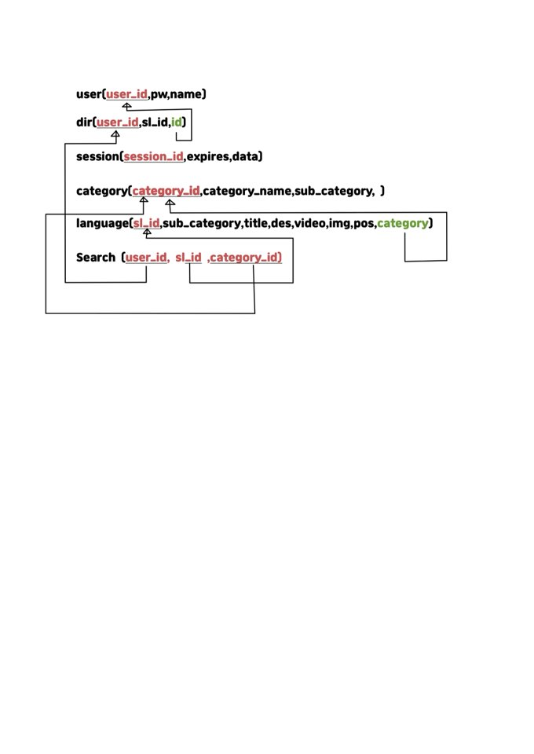
05
Database
Mapping result

Slide 12
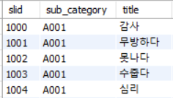
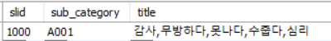
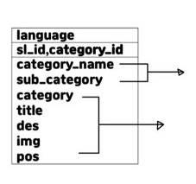
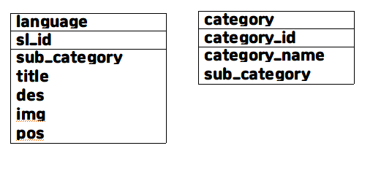
06
Tuning
1-Normalization
2-Normalization
Category_id
Category_id,sl_id

Slide 13
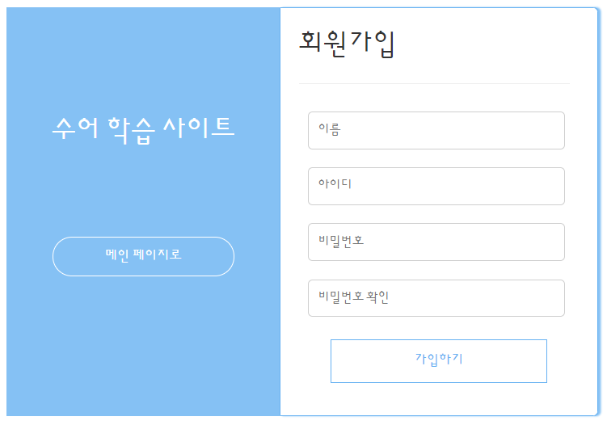
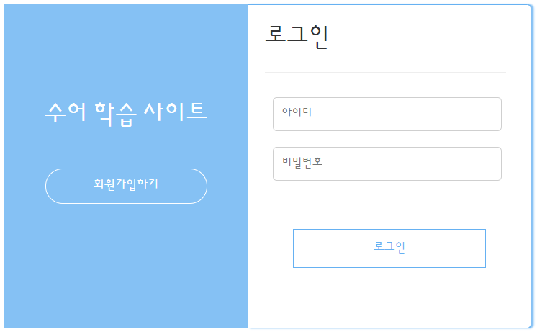
07
Queries
Query
- login/signup
1. Signup
2. Login
INSERT INTO user(user_id, pw, name) values(?,?,?)
SELECT * from user where user_id = ? and pw =?

Slide 14

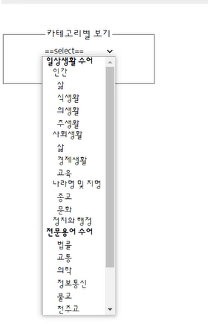
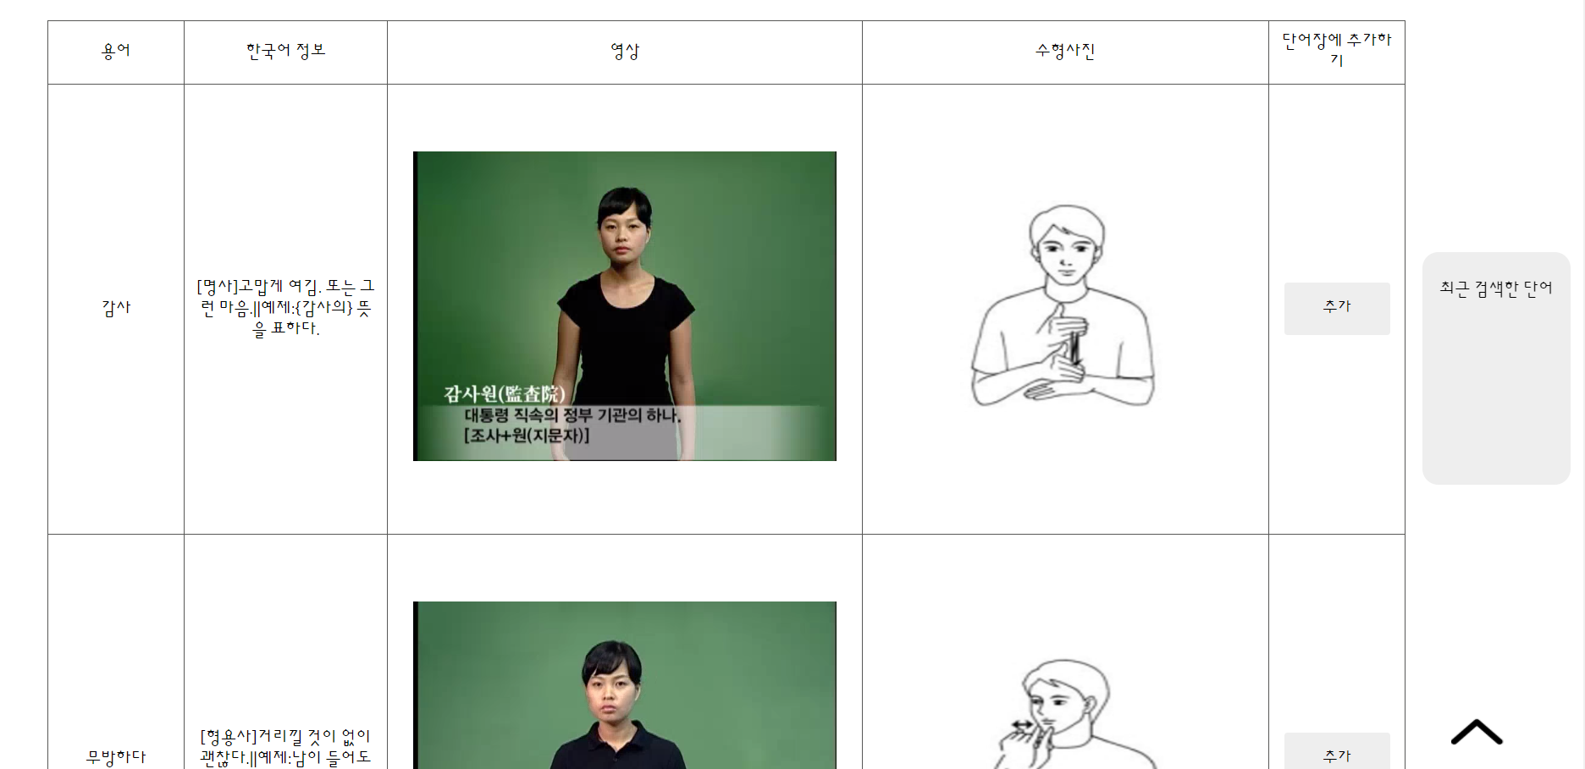
07
Queries
Query
- Search page
4. Show sign language belonging
to the category user select
3. Select Category
SELECT category_id FROM category
WHERE sub_category =
SELECT * from language where sub_category =

Slide 15
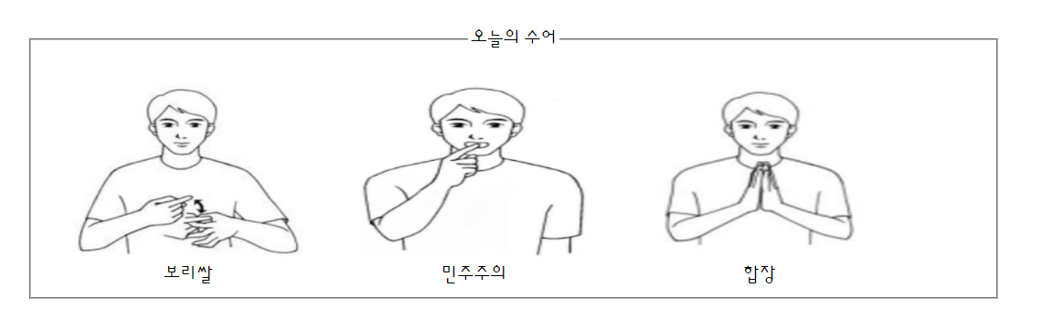
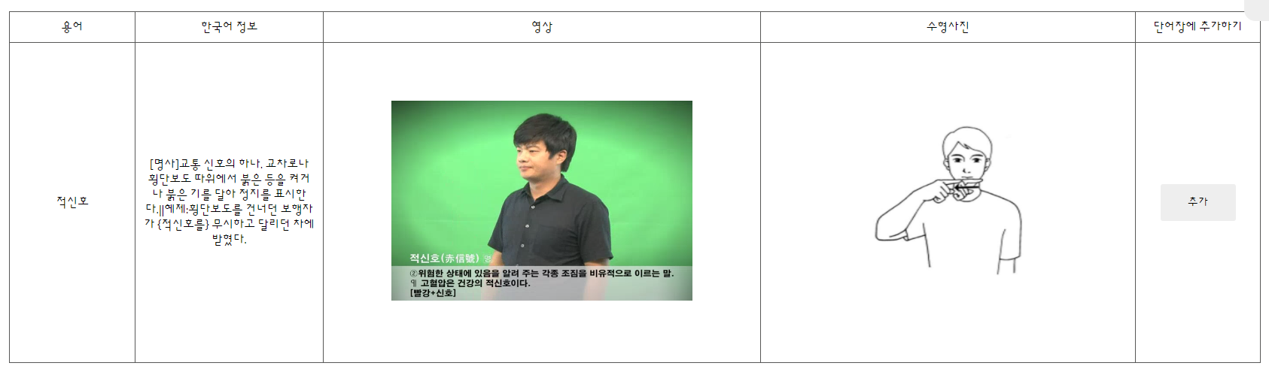
07
Queries
Query
- Search page
5. Searching sign language
6. Today’s sign language
SELECT * from language where title LIKE
SELECT slid, title, img from language
where slid=? or slid =? or slid =?

Slide 16
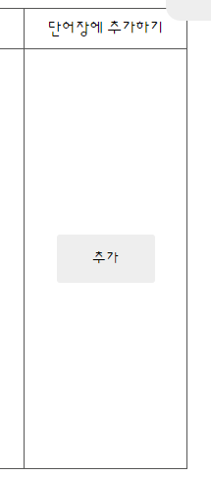
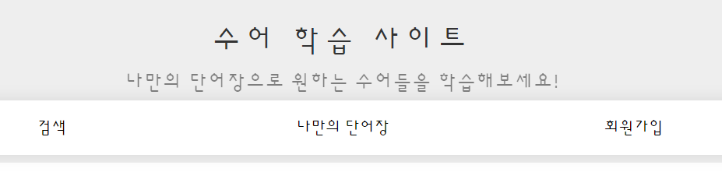
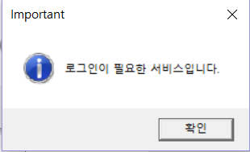
07
Queries
Query
- My voca page
7. Add my voca
8. Access my voca page
SELECT A.slid as slid, title, img from signlanguage as A
LEFT JOIN dir as B on A.slid = B.slid where user_id = ?
INSERT INTO dir(user_id, slid) values(?,?)

Slide 17
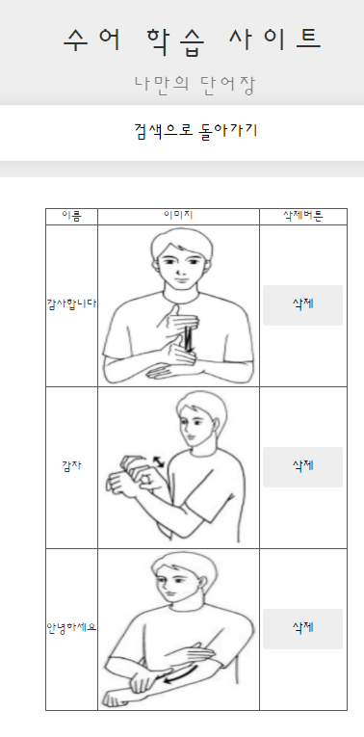
07
Queries
Query
- My voca page
9. Show my voca
SELECT A.slid as slid, title, img from signlanguage as A
LEFT JOIN dir as B on A.slid = B.slid where user_id = ?
10. Delete my voca
DELETE from dir where user_id=? and slid =?

Slide 18





08
Application
OpenSource

Slide 19
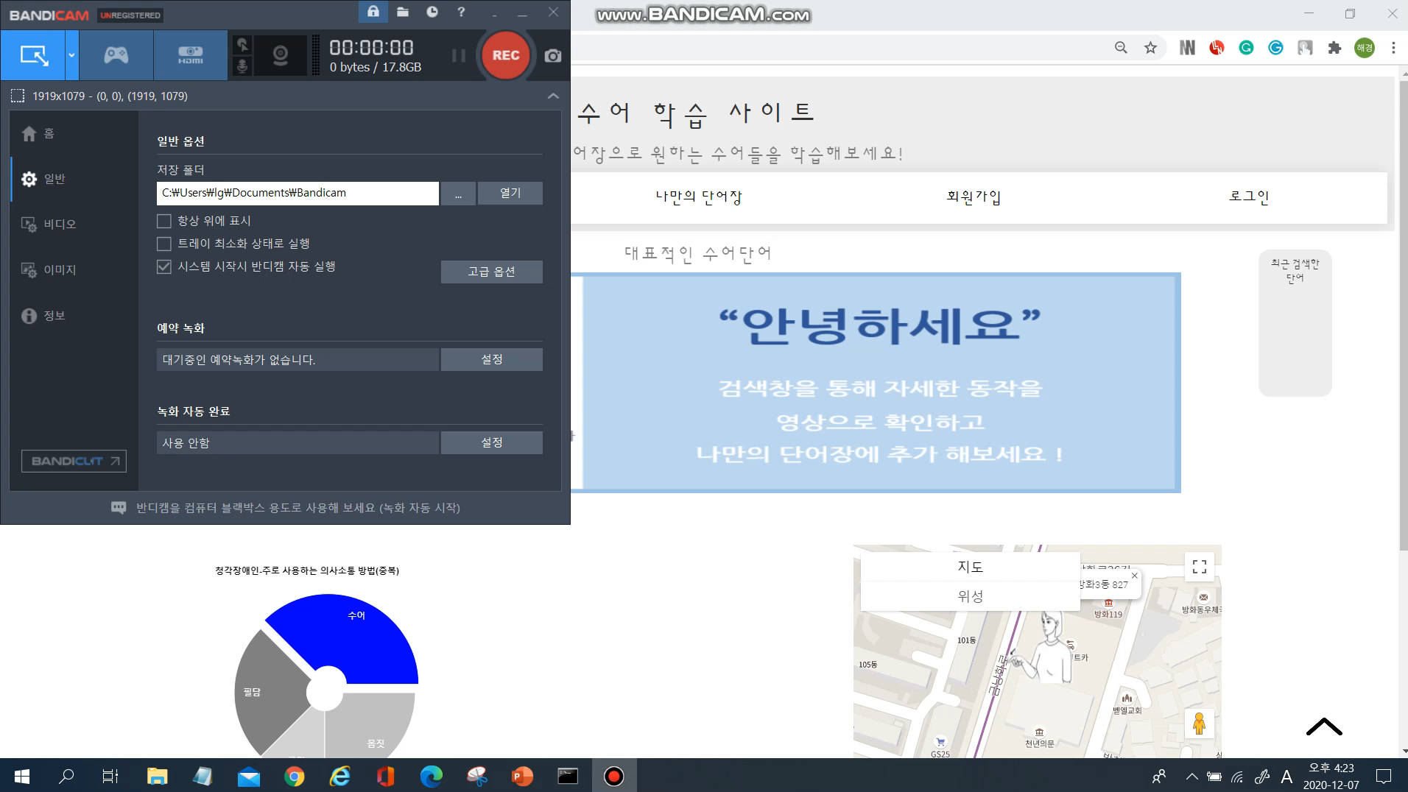
09
Demo

Slide 20




10
Conclusion
apply
Database
Application
Easy to Manage
Database Design

Slide 21
Thank you!

